Slide 1
Introduction to Exploratory Data Analysis & Data Preprocessing

Slide 2
Agenda
EDA overview
Types of variables
Measure of Central tendency
Measure of Dispersion
Skewness and Kurtosis
Correlation & Covariance
Univariate and Bivariate Analysis
Summary
Hands on

Slide 3
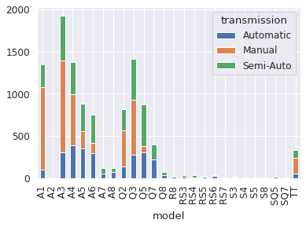
EDA Overview
Exploratory Data Analysis (EDA) is the first step which is done by a data scientist
To understand the data and summarize main characteristics
To check problems and inconsistencies like missing data, outliers, anomalies, etc with the data
To explore and analyse the sample and derive useful information, uncover underlying patterns and identify trends
To prepare the data for further analytics

Slide 4
Types of Variables
Quantitative data are numerical in nature and can be measured. Example - Price, Quantity etc.
Quantitative
Variables
Qualitative data are non numeric in nature and cannot be measured in terms of numbers. Example - Sex, City etc.
Qualitative
Bar plot
Notes:
Diagram Created Internally

Slide 5
Quantitative/Numerical
Quantitative (Numerical)
Continuous variable:
Discrete variable:
It can assume an infinite number of real values within a given interval. Example - Price of houses
It can take only certain values, and there are discontinuities between values.
Example - Number of students in a class
Continuous
Discrete

Slide 6
Qualitative/Categorical
Qualitative (Categorical)
Nominal:
Ordinal:
Data which can be separated into discrete categories which do not overlap. Example - male and female.
Data which is placed into some kind of order or scale. An example of ordinal data is rating feedback on a scale of 1-10.
Nominal
Ordinal

Slide 7
Measure of Central Tendency
Arithmetic Mean (called mean) is defined as the sum of all observations in a data set divided by the total number of observations.
Mean
Median is the middle most observation when you arrange data in ascending order of magnitude.
Median
Mode is that value which occurs most often. It has the maximum frequency of occurrence.
Mode
Notes:
Diagram created Internally

Slide 8
Measure of Dispersion
The variance of a random variable X is the expected value of the squared deviation from the mean of X. It is measured in squared units.
Variance
Standard Deviation
Standard deviation measures how spread out the values in a data set are around the mean. It is a square root of variance.
Range: (Largest value - smallest value) in a set of data
Interquartile range: Q3-Q1 (3rd quartile - first quartile)
Quantile: cut points dividing a set of data or distribution into intervals of equal probability.
Quartile: it’s a type of quantile which divides data into quarters. It’s a 4-quantile cut.
Percentile: 100-quantiles are called percentile
Notes:
Diagram created Internally

Slide 9
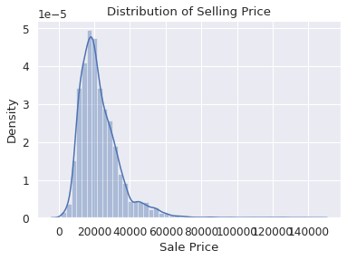
Measure of shape of distribution
Skewness
Tells the amount and direction of skew
Skew is defined as departure from horizontal summary.
The Karl Pearson’s Coefficient of Skewness is defined as,
S = 3(mean - median)
Where σ is the standard deviation
k
σ
Notes:
Diagram created Internally
Plot taken from hands-on

Slide 10
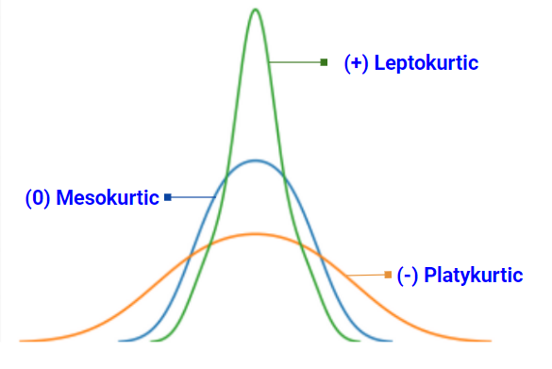
Measure of shape of distribution
Kurtosis
Measure of how a distribution is tailed relative to a normal distribution.
Gives a measure of how tall and sharp the central peak is, relative to a normal distribution

Slide 11
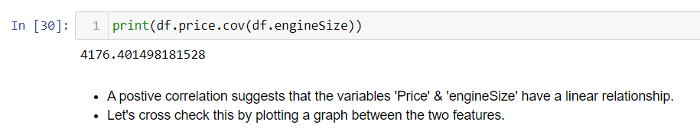
Covariance/Correlation
Covariance
Covariance is a measure of joint variability of two random variables.
It indicates the direction of the linear relationship between the variables.
Notes:
From hands-on

Slide 12
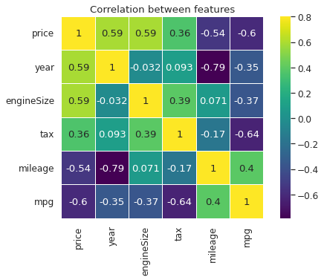
Covariance/Correlation
Correlation
To find the strength and direction of the relationship between two variables
Pandas corr() method - generates correlation matrix
Notes:
Graph taken from hands-on

Slide 13
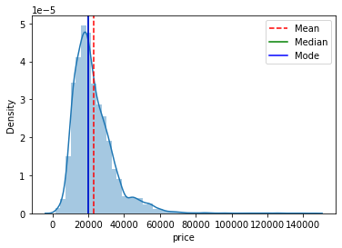
Univariate Analysis
Univariate analysis is a study of a single variable
It can be used:
To understand the distribution of one variable
Trend and pattern of the variable
Statistical summary of the variable
To find anomalies in the variable
Notes:
Graph taken from hands-on

Slide 14
Univariate Analysis
Statistical summary tells a lot about a feature. It is used to derive insights and prepare a feature for model building
For continuous features, we should check the summary statistics
For categorical features, we can check the value counts or frequency table
Using Statistical Method
Univariate Analysis
Plots are also very useful to understand the trend of the variable
For continuous features, we can go with common distribution and summary plots
For categorical features, we can go for frequency plots
Using Visualisation
Bar plot
Notes:
Diagram Created Internally

Slide 15
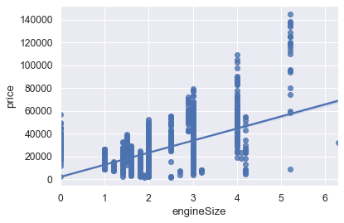
Bivariate Analysis
Helps to understand relationship between two variables
There are many statistical methods to derive insights about relationship between two variables
Correlation: analysis between two continuous variables
Crosstab/frequency table: analysis of two categorical variables
Scatterplot: analysis of any two given variables
Notes:
Plot taken from hands-on

Slide 16
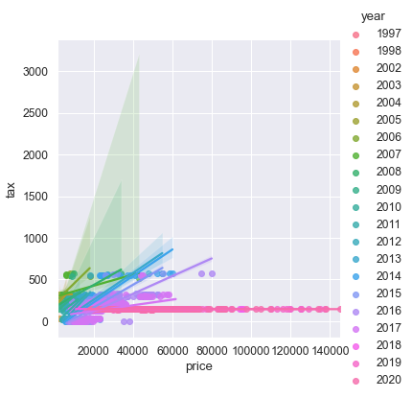
Multivariate Analysis
Multivariate means involving multiple dependent variables resulting in one outcome
Helps to understand complex data
Conclusion drawn are more realistic
Can be used to:
Find Relationships between variables
Investigate of dependence among variables
Reduce and simplify the data
Group variables
Derive insights and find patterns and trends in the data
Notes:
Diagram created Internally

Slide 17
Hands on
Case Study: Exploratory Data Analysis
Objective: To Perform Exploratory data analysis on used cars dataset and analyzing the dataset to summarize their main characteristics using pandas, statistical graphs and other data visualization methods. It is a good practice to understand the data first and try to gather as many insights from it. EDA is all about making sense of data
Dataset Description:
Scraped data of used cars listings for the Audi car manufacturers.
The cleaned data set contains information of price, transmission, mileage, fuel type, road tax, miles per gallon (mpg), and engine size.
The dataset is free from any duplicate or missing values.

Slide 18
Hands on - Questions
Verify if the selling price is centered around 20K. Compute the mean, median and mode and comment on it. Use visualization methods to visualise the distribution.
It is assumed that the road tax paid by the car owners for different models is similar and there is not much spread/variation in the data. Find the range for the tax column and comment on this assumption.
Find the direction and strength of relationship among the different pairs of variables using appropriate plot and write your findings. Comment on the relationship between engine_size and price.
It is assumed that when the engine size increases the price of the car also increases significantly. Find the covariance between price and engine size and comment on this assumption.

Slide 19
Some Important Questions
Q) What is the difference between correlation and covariance?
Covariance signifies the direction of the linear relationship between the two variables. (f the variables are directly proportional or inversely proportional to each other)
Correlation signifies direction as well as strength of the linear relationship between two variables.
Correlation can be considered as the normalized value of covariance
Q) Explain descriptive, predictive and prescriptive analytics.
From descriptive analytics we will get to know what has happened in the past
Predictive is to understand what can happen in the future
Prescriptive we will be suggesting what should be done in the future.

Slide 20
Some Important Questions
Q) Differentiate between univariate, bivariate, and multivariate analysis.
Univariate as the name suggests ‘Uni” it is on single variable, can be described using central tendency, measure of dispersion and shape of distribution and using univariate plots such as pie, bar, hist plots etc.
Bivariate involves analysis of two variables to find variation and relationships with each other.
Multivariate analysis involves the analysis of three or more variables to understand the relationship of each variable with the other variables.
Q) What would the pattern of mean, median, and mode values in a negatively skewed data?
If the value of mean is lesser than the median and mode then the distribution is negatively skewed.

Slide 21
Can we implement this session learnings on titanic data??
Try to find the mean, median and mode for the column ‘Fare’ .
Find the age range for the passengers of the titanic.
Is the distribution of the column ‘Fare’ skewed? Visualize the distribution of the fare paid by the customers and find the skewness value and comment on the same.
Find the range of middle 50% of the data for the column ‘Fare’.
Is there any linear relationship between age and fare?
Is there any relationship between gender, age, and survival rate?

Slide 22
Summary
In this module we discussed:
EDA overview and EDA in analytics cycle
Sources and types of data, types of variables.
Measures of central tendency and measures of dispersion.
Measures of shape of distribution.
Correlation and covariance
Univariate, bivariate analysis.
Notes:
Diagram created Internally

Slide 23
Thank you Happy learning ☺

